Slide 1
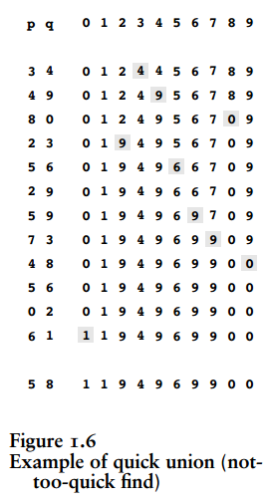
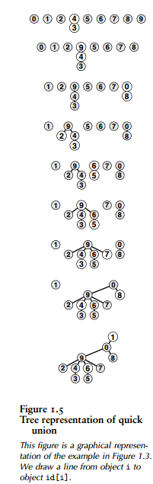
quick-union (Page 15)
After adding “2,3”, “2” was connected to “9” which is the root of “3”

